Slide 1
Python Project
By- Dr. Bushra Mirza
Gautam Thareja
Parminder Singh

Slide 2
Merging and Analyzing the Data
Data Collection and Cleaning:
a. checking the null values
: print(merged_df1.isnull().sum())
b. The weight column has more irrelevant values. This will interfere in the analysis. Also, we do not need weight for our analysis. So moving further by dropping the weight column.
: merged_df1.drop(['weight'], axis=1, inplace=True)

Slide 3

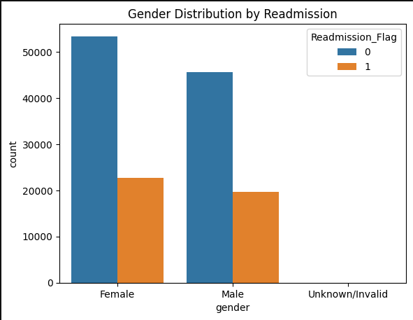
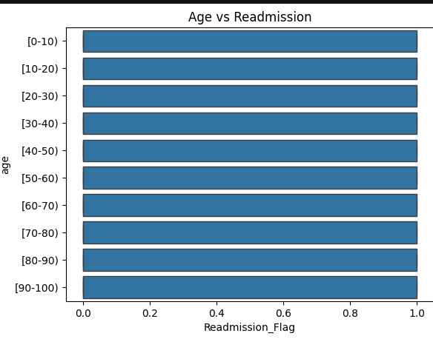
Exploratory Analysis and Data Visualization
Graphs
1. sns.countplot(data=merged_df1, x='gender', hue='Readmission_Flag')
plt.title('Gender Distribution by Readmission')
plt.show()
##This chart highlights the gender-wise distribution of patients with and without readmission (flagged as 0 and 1 respectively).
2. sns.boxplot(data=merged_df1, x='Readmission_Flag', y='age') plt.title('Age vs Readmission') plt.show()
This horizontal bar chart represents the distribution of readmission flags (0 and 1) across different age groups.

Slide 4
Investigating Patterns and Relationships
As I see there are 22 columns that contain individual drug administration data. We do not need these columns in our analysis.
merged_df1.drop(['metformin', 'repaglinide', 'nateglinide', 'chlorpropamide','glimepiride', 'acetohexamide', 'glipizide', 'glyburide', 'tolbutamide', 'pioglitazone', 'rosiglitazone', 'acarbose', 'miglitol', 'troglitazone', 'tolazamide', 'examide', 'citoglipton','glyburide-metformin', 'glipizide-metformin', 'glimepiride-pioglitazone', 'metformin-rosiglitazone', 'metformin-pioglitazone'], axis=1, inplace=True)
merged_df1

Slide 5
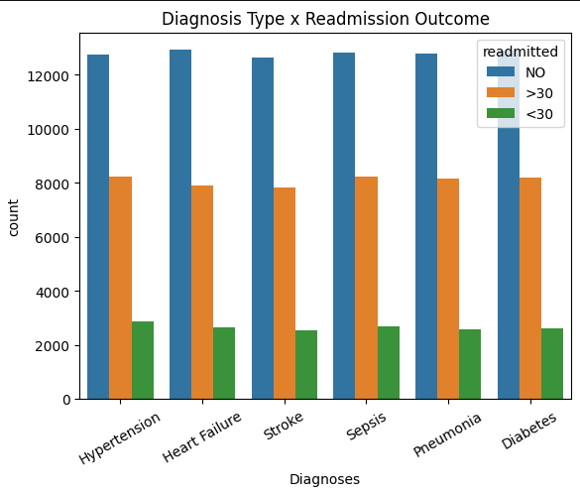
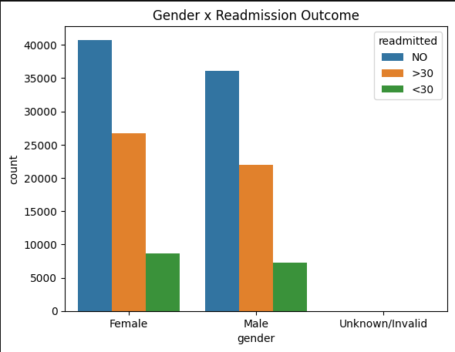
Explore potential differences in outcomes patient characteristics.
Interpretation:
The Readmissions seen in Female more than Male
Interpretation:
Total number of Type of Diagnosis seen in the overall admissions – 6
Type of diagnosis are - Hypertension, Heart failure, Stroke, Sepsis, Pneumonia, Diabetes

Slide 6
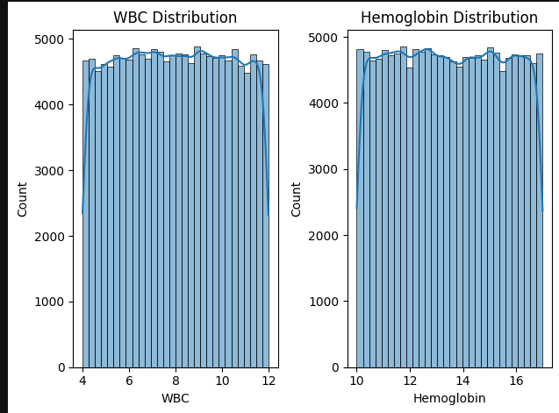
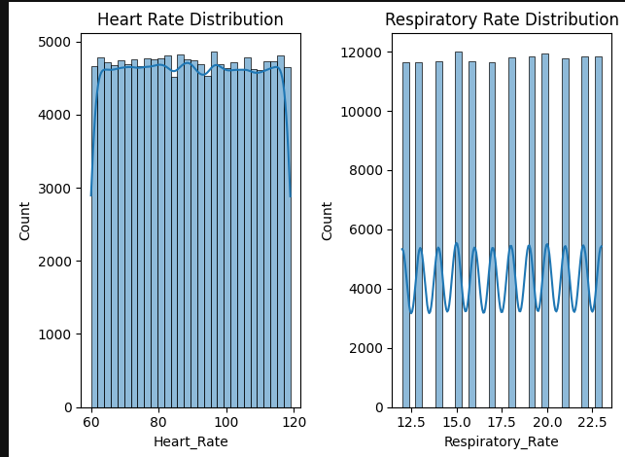
The distribution of clinical features to identify trends
# Histogram for Heart Rate
plt.subplot(1, 2, 1)sns.histplot(x=merged_df1['Heart_Rate'], bins=30, kde=True) plt.title('Heart Rate Distribution')
# Histogram for Respiratory Rate
plt.subplot(1, 2, 2)sns.histplot(x=merged_df1['Respiratory_Rate'], bins=30, kde=True) plt.title('Respiratory Rate Distribution')
plt.tight_layout()
plt.show()
# Histogram for Hemoglobin
plt.subplot(1, 2, 2) sns.histplot(x=merged_df1['Hemoglobin'], bins=30, kde=True) plt.title('Hemoglobin Distribution')
# Histogram for WBC
plt.subplot(1, 2, 1) sns.histplot(x=merged_df1['WBC'], bins=30, kde=True)plt.title('WBC Distribution')
plt.tight_layout()
plt.show()

Slide 7
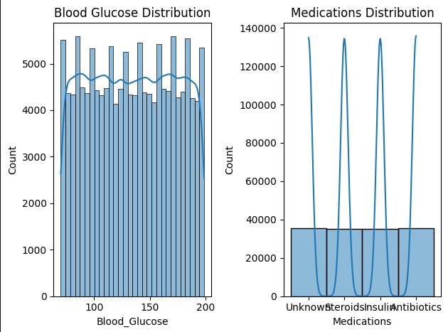
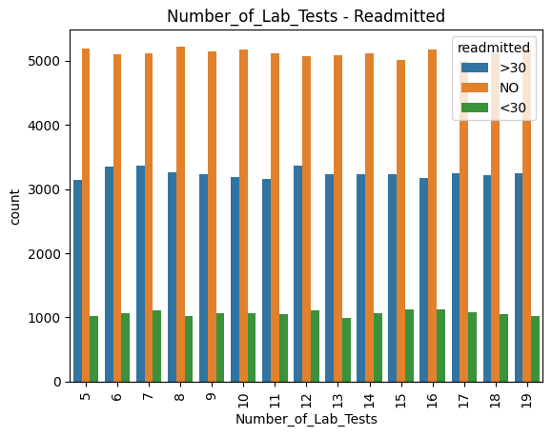
# Histogram for glucose levels
plt.subplot(1, 2, 1)sns.histplot(x=merged_df1['Blood_Glucose'], bins=30, kde=True) plt.title('Blood Glucose Distribution')
# Histogram for Medications
plt.subplot(1, 2, 2)sns.histplot(x=merged_df1['Medications'], bins=30, kde=True) plt.title('Medications Distribution')
plt.tight_layout()
plt.show()
# Relation of Number of Lab tests to Readmission
sns.countplot(x='Number_of_Lab_Tests', hue= "readmitted", data = merged_df1)
plt.xticks(rotation=90)
plt.title("Number_of_Lab_Tests - Readmitted")
plt.show()

Slide 8
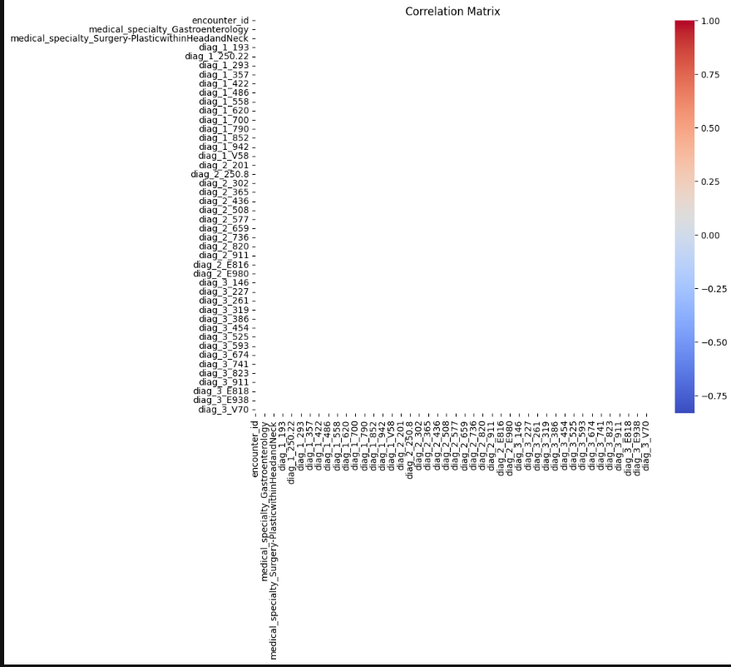
Predicting Patient Outcomes
# Correlation matrix
plt.figure(figsize=(10, 8))
sns.heatmap(encoded_df.corr(), annot=False, cmap='coolwarm', fmt='.2f', linewidths=0.5)
plt.title('Correlation Matrix')
plt.show()

Slide 9
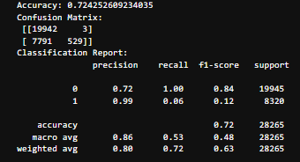
# Evaluate model
print('Accuracy:', accuracy_score(y_test, y_pred))
print('Confusion Matrix:\n', confusion_matrix(y_test, y_pred))
print('Classification Report:\n', classification_report(y_test, y_pred))

Slide 10
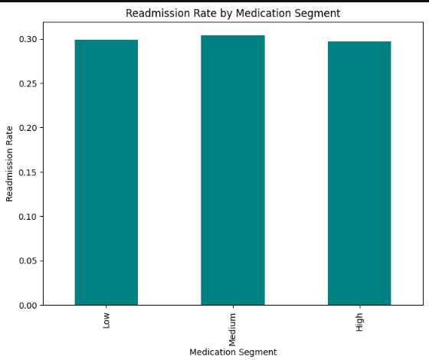
# Plot segment analysis
plt.figure(figsize=(8, 6)) segment_analysis.plot(kind='bar', color='teal') plt.title('Readmission Rate by Medication Segment') plt.xlabel('Medication Segment') plt.ylabel('Readmission Rate')
plt.show()

